Slide 1
The force is strong in LLMs Building a Star Wars inspired copilot
Jim Bennett
Head of developer advocacy
Pieces for Developers
@JimBobBennett
Linktr.ee/jimbobbennett

Slide 2

Notes:
Hello there
Who is a Star Wars fan?
Original? Prequal? Sequel? Just love it for baby yoda?
More importantly, who uses a copilot or other AI tool to help them write code?

Slide 3
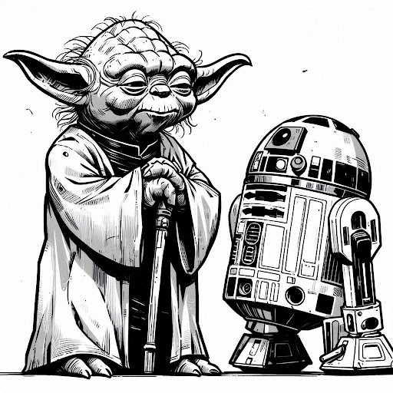
Demo my copilot, I will.
Notes:
Let’s do a demo of 2 copilots - one inspired by R2-D2, and one by Yoda.
R2D2
How can I destroy the death star?
Is the emperor aboard?
Yoda
Ask about the all things open conference
Ask how to build an ASP.net program with a endpoint to detect if a name is from a sith lord
Ask are there any more sith lords to add to this?
What was I just doing?

Slide 4
Hello, what have we here?
Notes:
So what do we actually have here code wise to make this work?
Let’s take a moment to dig into the architecture.

Slide 5
Abstraction Layer
(PiecesOS)
LLM
REST API
Pieces .NET Client SDK
Copilot app
Notes:
We have an LLM. I’m using GPT-4o here, but everything we are doing can be done on a range of LLMs, both cloud and on device.
Over the top of this is an abstraction layer that handles conversations with the LLM. In this case Pieces OS, which is part of Pieces for Developers. I’ll be diving into parts of how this abstraction layer works later as we dig into how copilots work.
To do all of this, you need Pieces installed.
Pieces OS has a REST API that we use internally for the various components of Pieces such as our desktop app and IDE extensions. In itself it’s not very user friendly as this is designed for internal use.
So to make this nicer, we have an open source SDKs that sit on top that to wrap things up in a way that makes it easier to use. We have Python and C#, and use the Python one for our open source plugins for tools like Neovim, Sublime and our Pieces CLI
The C# SDK we have has 2 parts - a Client SDK that provides a nice interface with some Pieces specific features, and an implementation of Microsoft.Extensions.AI using Pieces as the LLM.
Anyone .NET heard of Microsoft.Extensions.AI?

Slide 6
dotnet add package Pieces.Extensions.AI --prerelease
Notes:
If you are a .NET developer, then you can install the client .NET SDK, or the Pieces.Extensions.AI to have Microsoft.Extensions.AI compatibility.

Slide 7
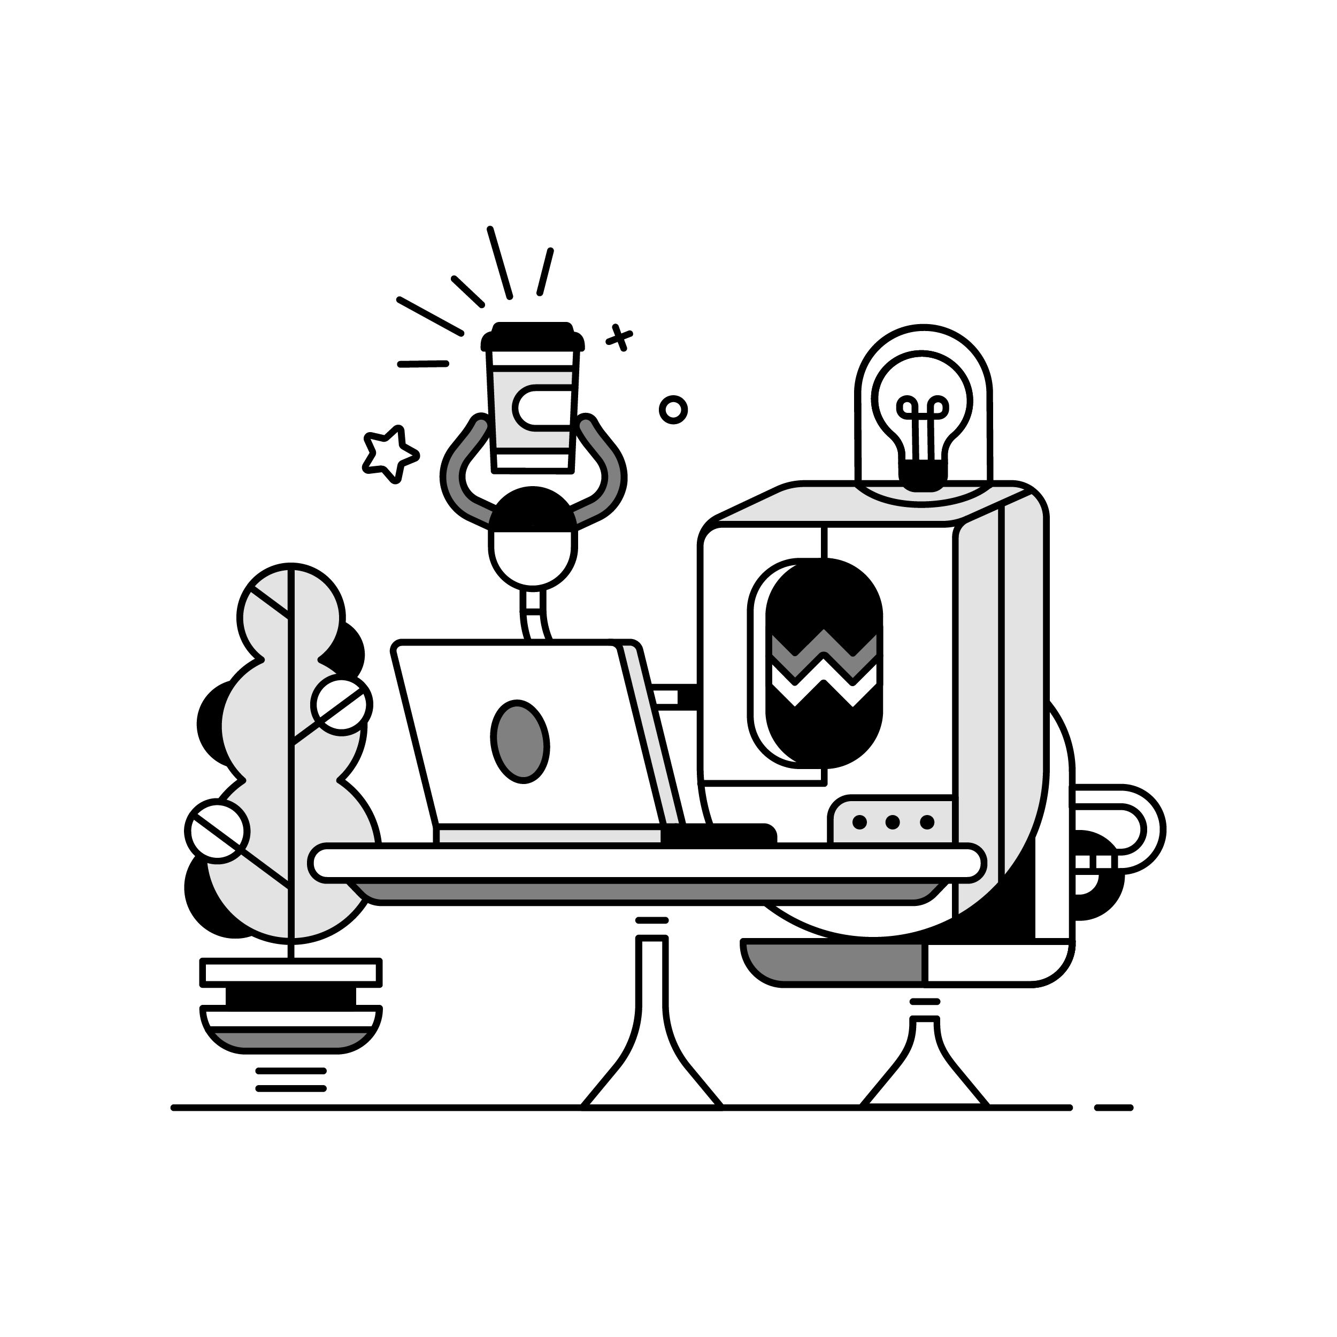
Let’s write some code
Notes:
Let’s write some code to build this copilot and learn about the concepts on the way. For simplicity I am hard coding the messages, but in a copilot you would have a way for the user to type their question.
Create a new console app using Pieces.Extensions.AI
Add the first, second, and third code snippet, then run. Chat message = prompt
Add the fourth then run
Walk through the chat messages collection that is being built up. Remember LLMs are stateless, so need the entire chat history.

Slide 8
What was sent to the LLM?
User
Assistant
User
How can I create a ”Hello World” application in C#?
You can create a ”Hello World” application in C# by using the following code…
How can I make this a “Hello There” application?

Slide 9

How do we make our copilot sound like R2-D2?
Notes:
How did we make the conversation sound like R2? There’s another message type we can use - a system message.
This is sent at the start, and provides the LLM with basic instructions to follow.
A lot of chat apps have custom system prompts to help guide them. For example, the Pieces system prompt tells the LLM to be a developer with a certain amount of experience who is skilled at answering questions. These system prompts can have a lot of control over the LLM.

Slide 10
Let’s write some code
Notes:
Let’s write some code to set a system prompt
Add snippet 5 to set a system prompt
Run the project, show how the prompt influences the output
Change system prompt to snippet 6
Run the project, show how the prompt influences the output
System prompts can be short like this, or contain a lot of useful information to guide the LLM. Let’s look at one example now

Slide 11
What was sent to the LLM?
System
User
Assistant
User
Answer everything in the style of Luke Skywalker from Star Wars…
How can I create a ”Hello World” application in C#?
You can create a ”Hello World” application in C# by using the following code…
How can I make this a “Hello There” application?

Slide 12
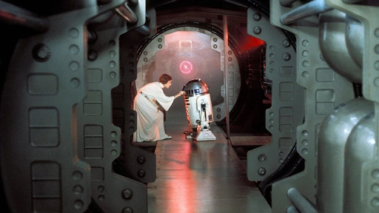
Notes:
In our demo earlier, R2 knew about the death star - or at least a C# project about it. How did it know this?
The reason it knew is because the project was added as context to the LLM.

Slide 13
Let’s write some code
Notes:
Remove the existing chat and chatmessages collection
Add snippet 7 with the options
Add snippet 8 with the new messages and run the code
Add snippet 9 with the follow up question and run the code

Slide 14
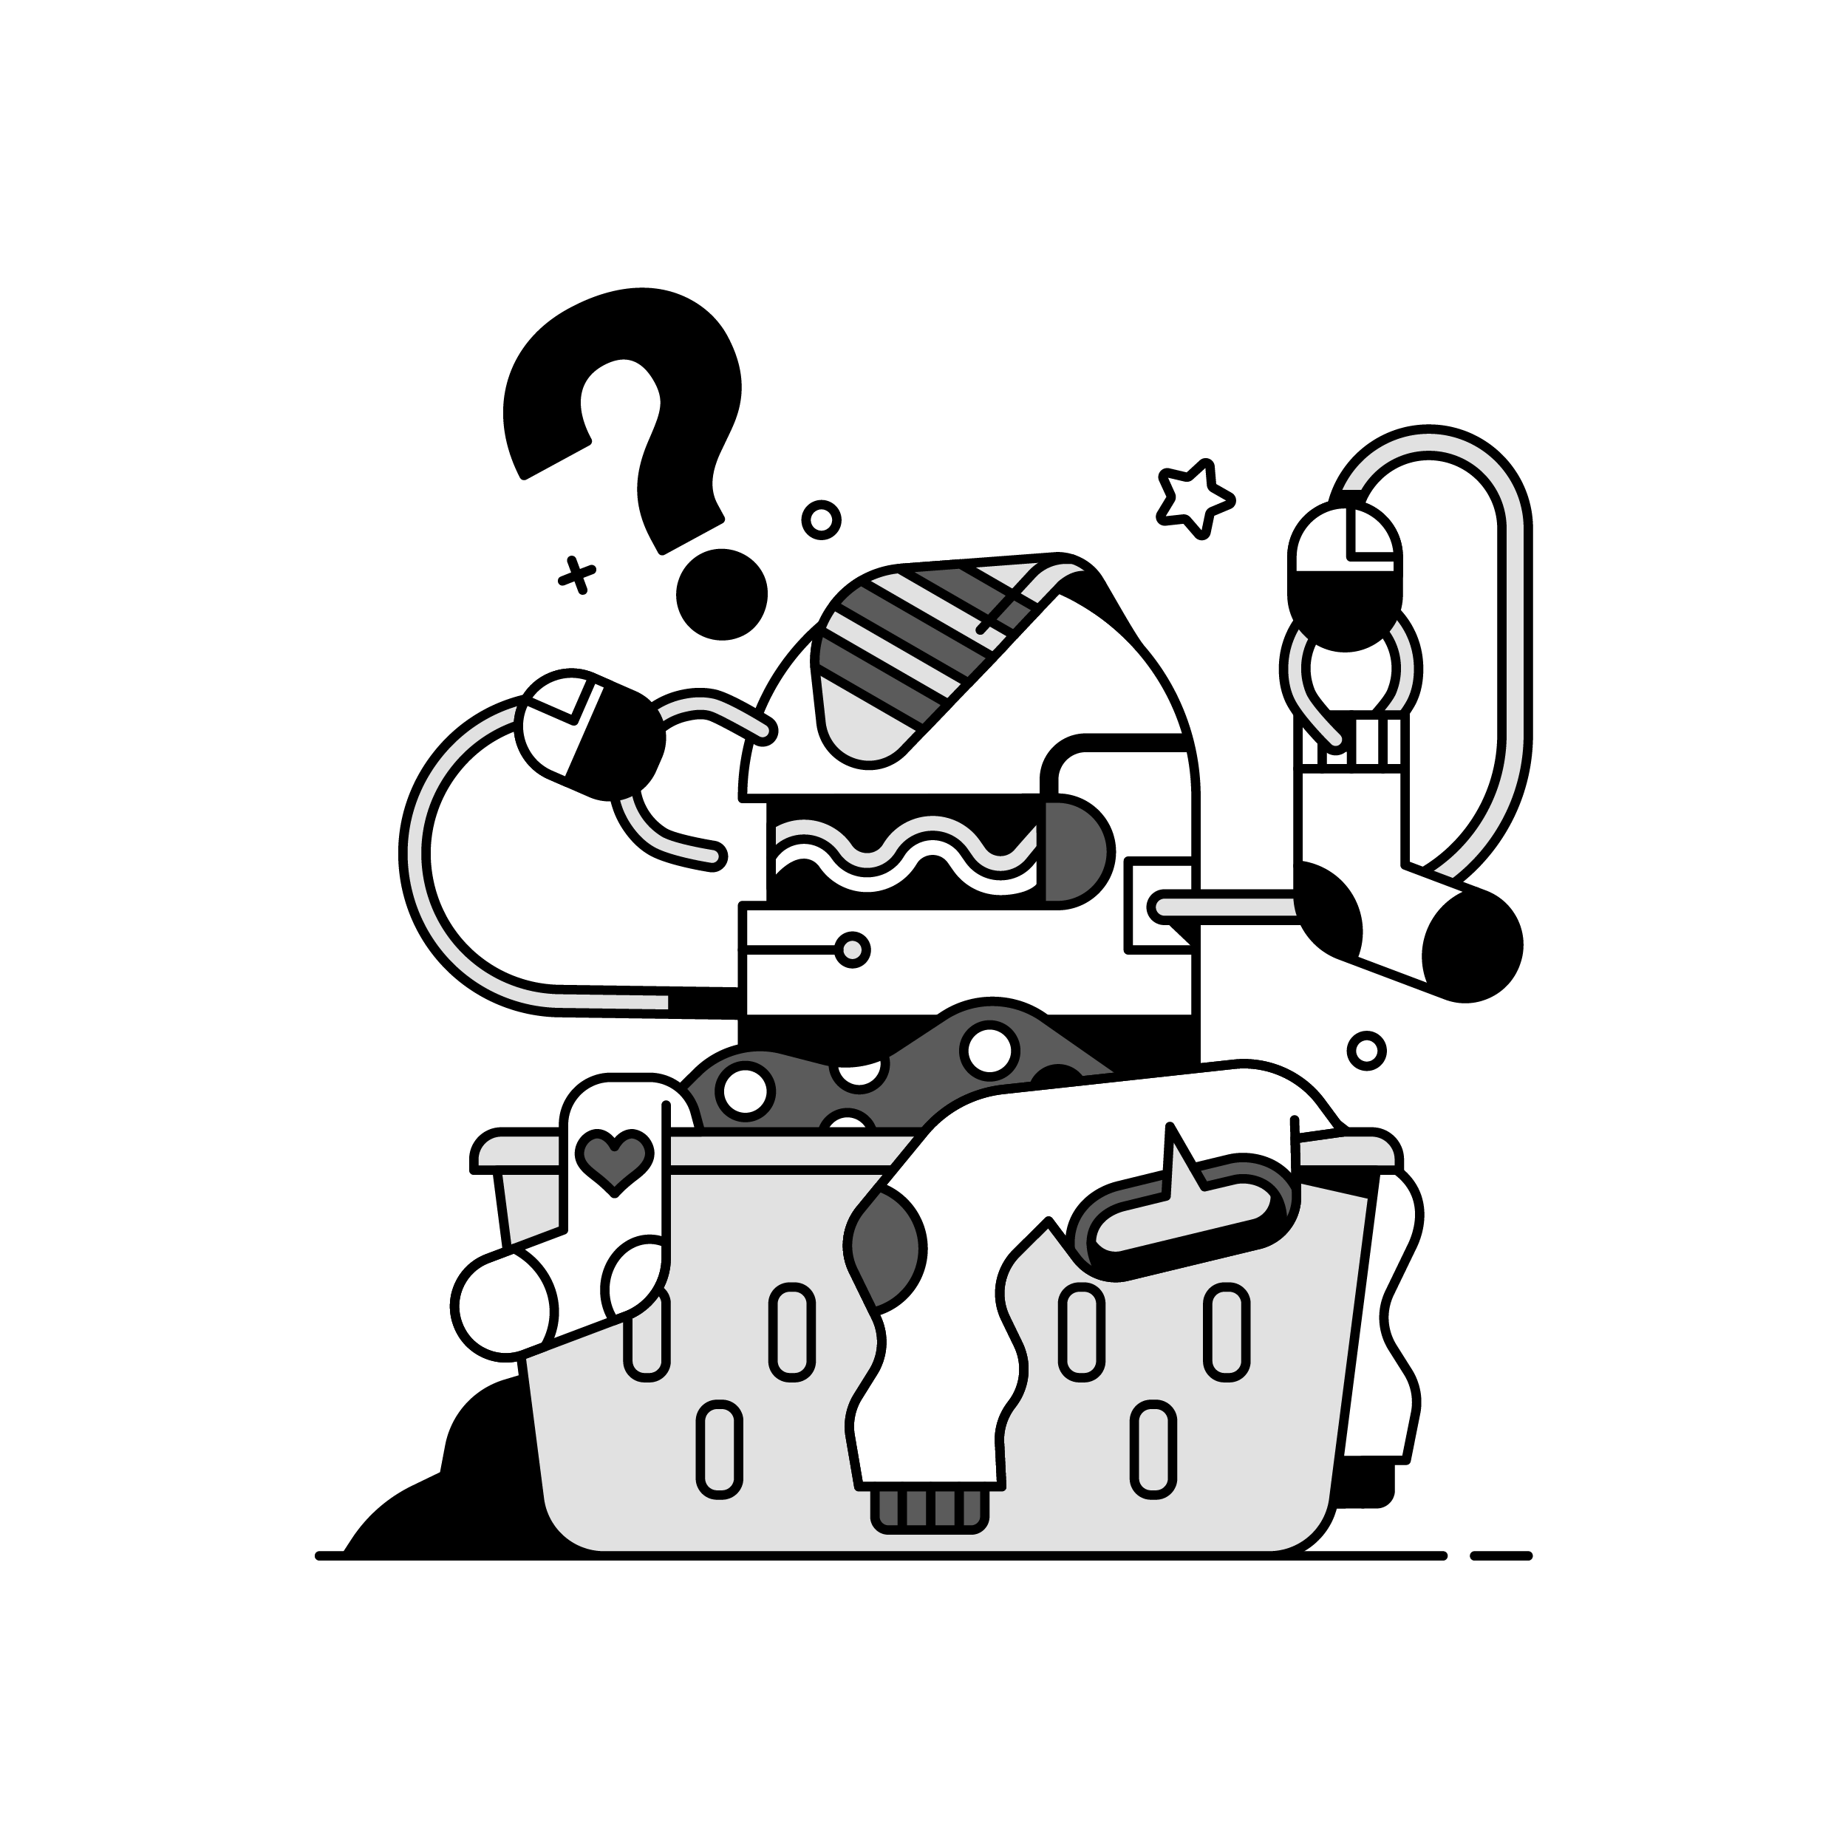
What gets added as context?
Notes:
LLMs have a context window size - and this is defined using tokens, which are short words or parts of longer words, think about 4 characters per token.
If you exceed this size, the extra tokens are lost.
GPT - 128k, Gemini 2M,
Ideally you want to limit the context you send. The example Death Star project is small, but how many folks work with 1M LOC projects or larger.
How can you limit?

Slide 15
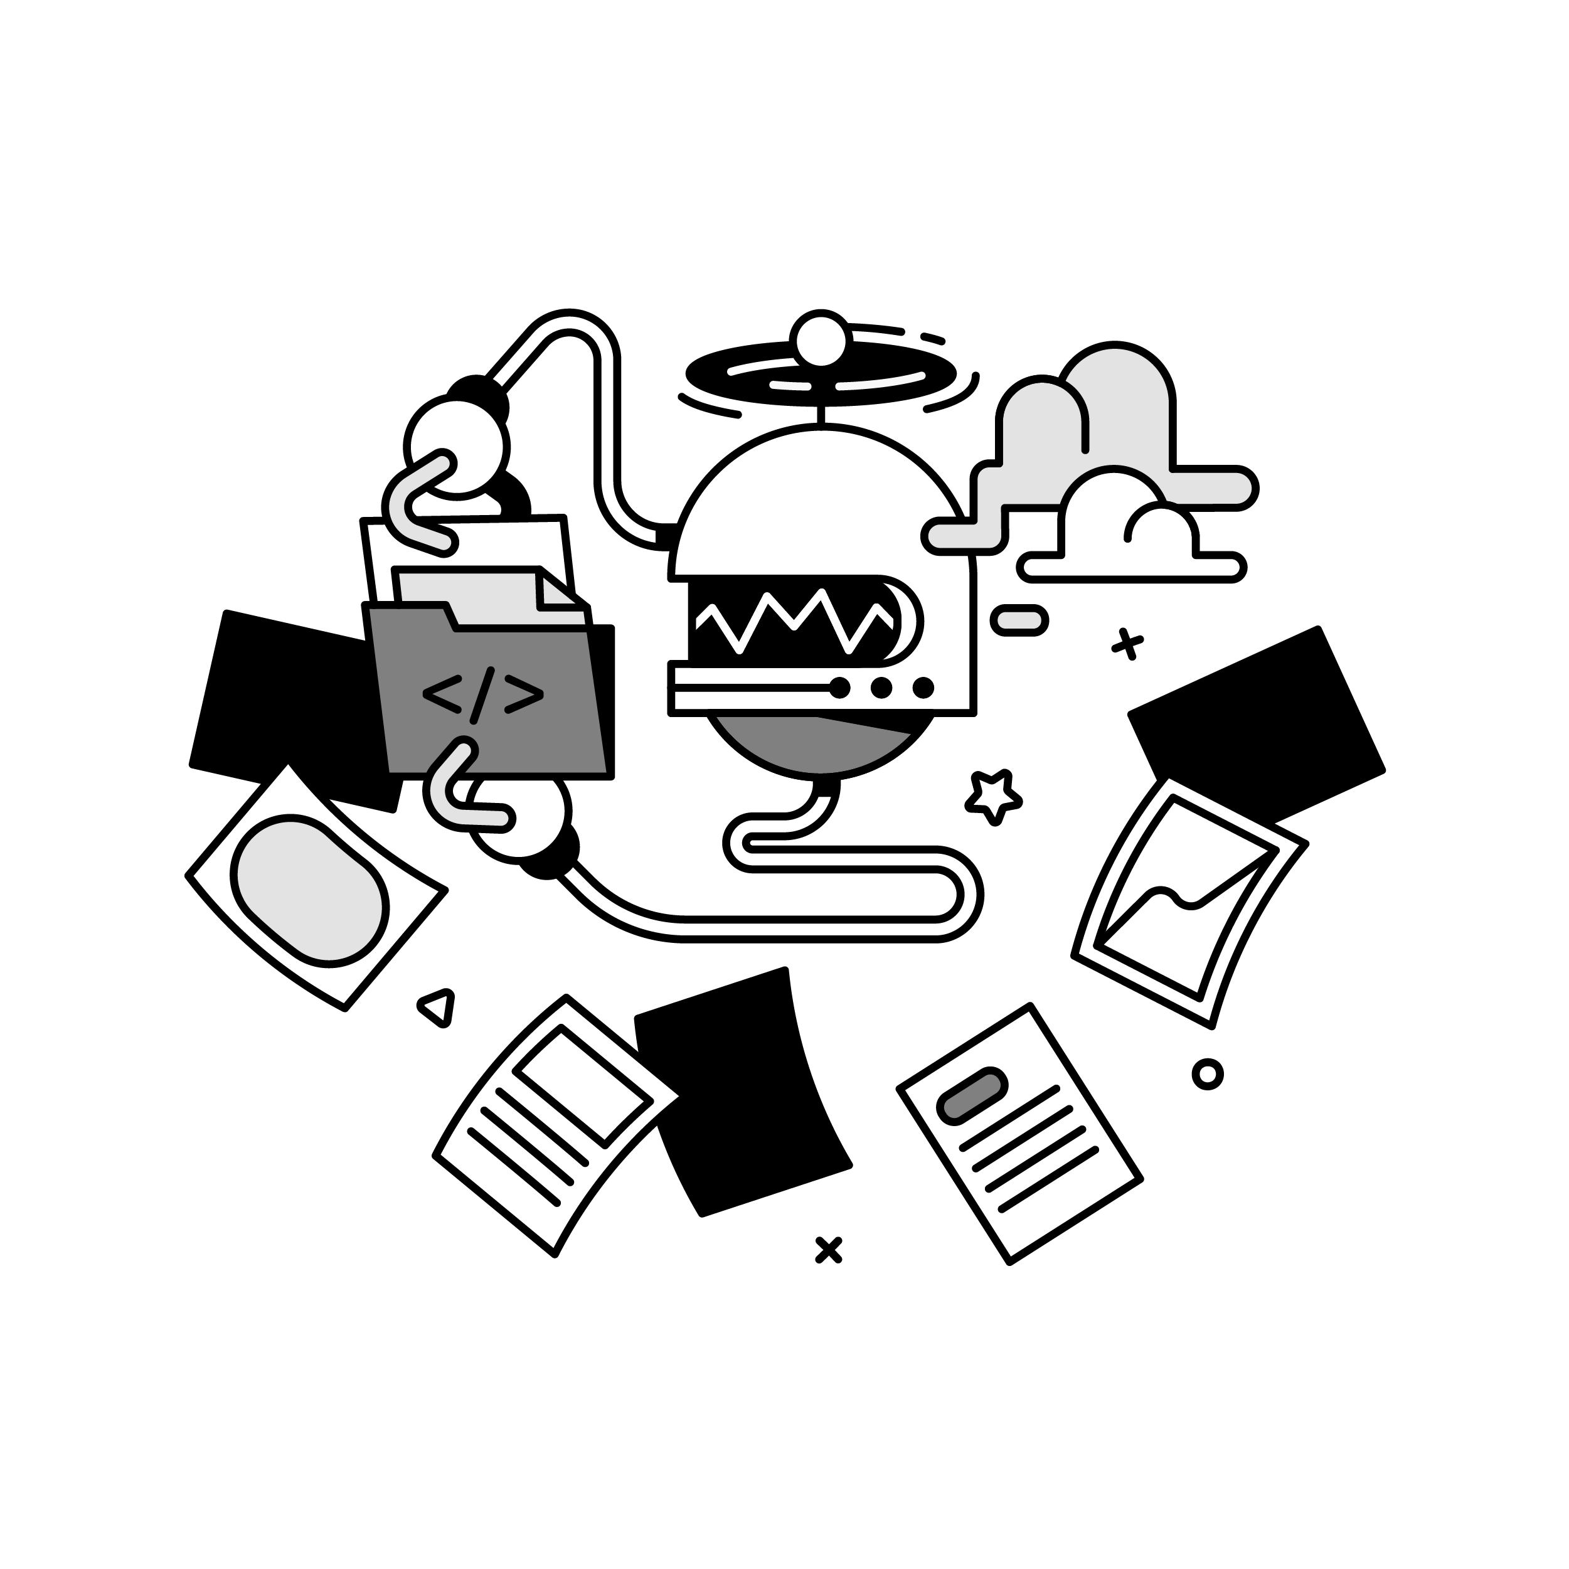
RAG – retrieval augmented generation
Notes:
The right way to add context to your copilot is using RAG - retrieval augmented generation.
This is the process of taking information from the prompt and using that to do a lookup of other information.
For example, if you have a prompt about an order in a ecommerce platform, you could detect this, then look up the order in your database, and add the order details to the chat.
In the case of adding code, you need to work out what is relevant and send only that code.
Pieces does a lot of this for you.

Slide 16

Relevancy detection
Notes:
The best way to do this is to convert the code to vector embeddings and add these to a vector database. These are database that save text as multi-dimensional vectors. But put simply, they group things by similarity. For example, cat and dog would be very close in a vector database, but cat and a null pointer exception would be a long way apart.
Code blocks that are similar to the prompt are retrieved from the vector database, and only these are sent to the LLM. These go in the system prompt, providing the base information the LLM needs.
This way if you have for example a huge web project, and you ask about the order page, only code relevant to orders and the order page would be sent to the LLM, not code relevant to the about page.
This is an over-simplification, but you get the idea.
Pieces does this automatically for you - you just pass the folder and it will pull the relevant code out.

Slide 17

Notes:
In the demo earlier of the Yoda copilot, I asked what I was doing, and through the living force, Yoda was able to sense what I was up to. So how did he know?
Pieces has a feature called long term memory, that captures relevant context from the activities you are doing. It can then surface these in a conversation.

Slide 18
Let’s write some code
Notes:
Try the LLM with live context. Who has played Star Wars outlaws?
Open wookiepedia and read the page on Kay Vess
Back to the code
Change the model to phi-3k
Replace the chat message with snippet 13
Run the code - not much detail as that was all that was available when the LLM was trained
Add snippet 14 with live context options
Run the code again - more details

Slide 19
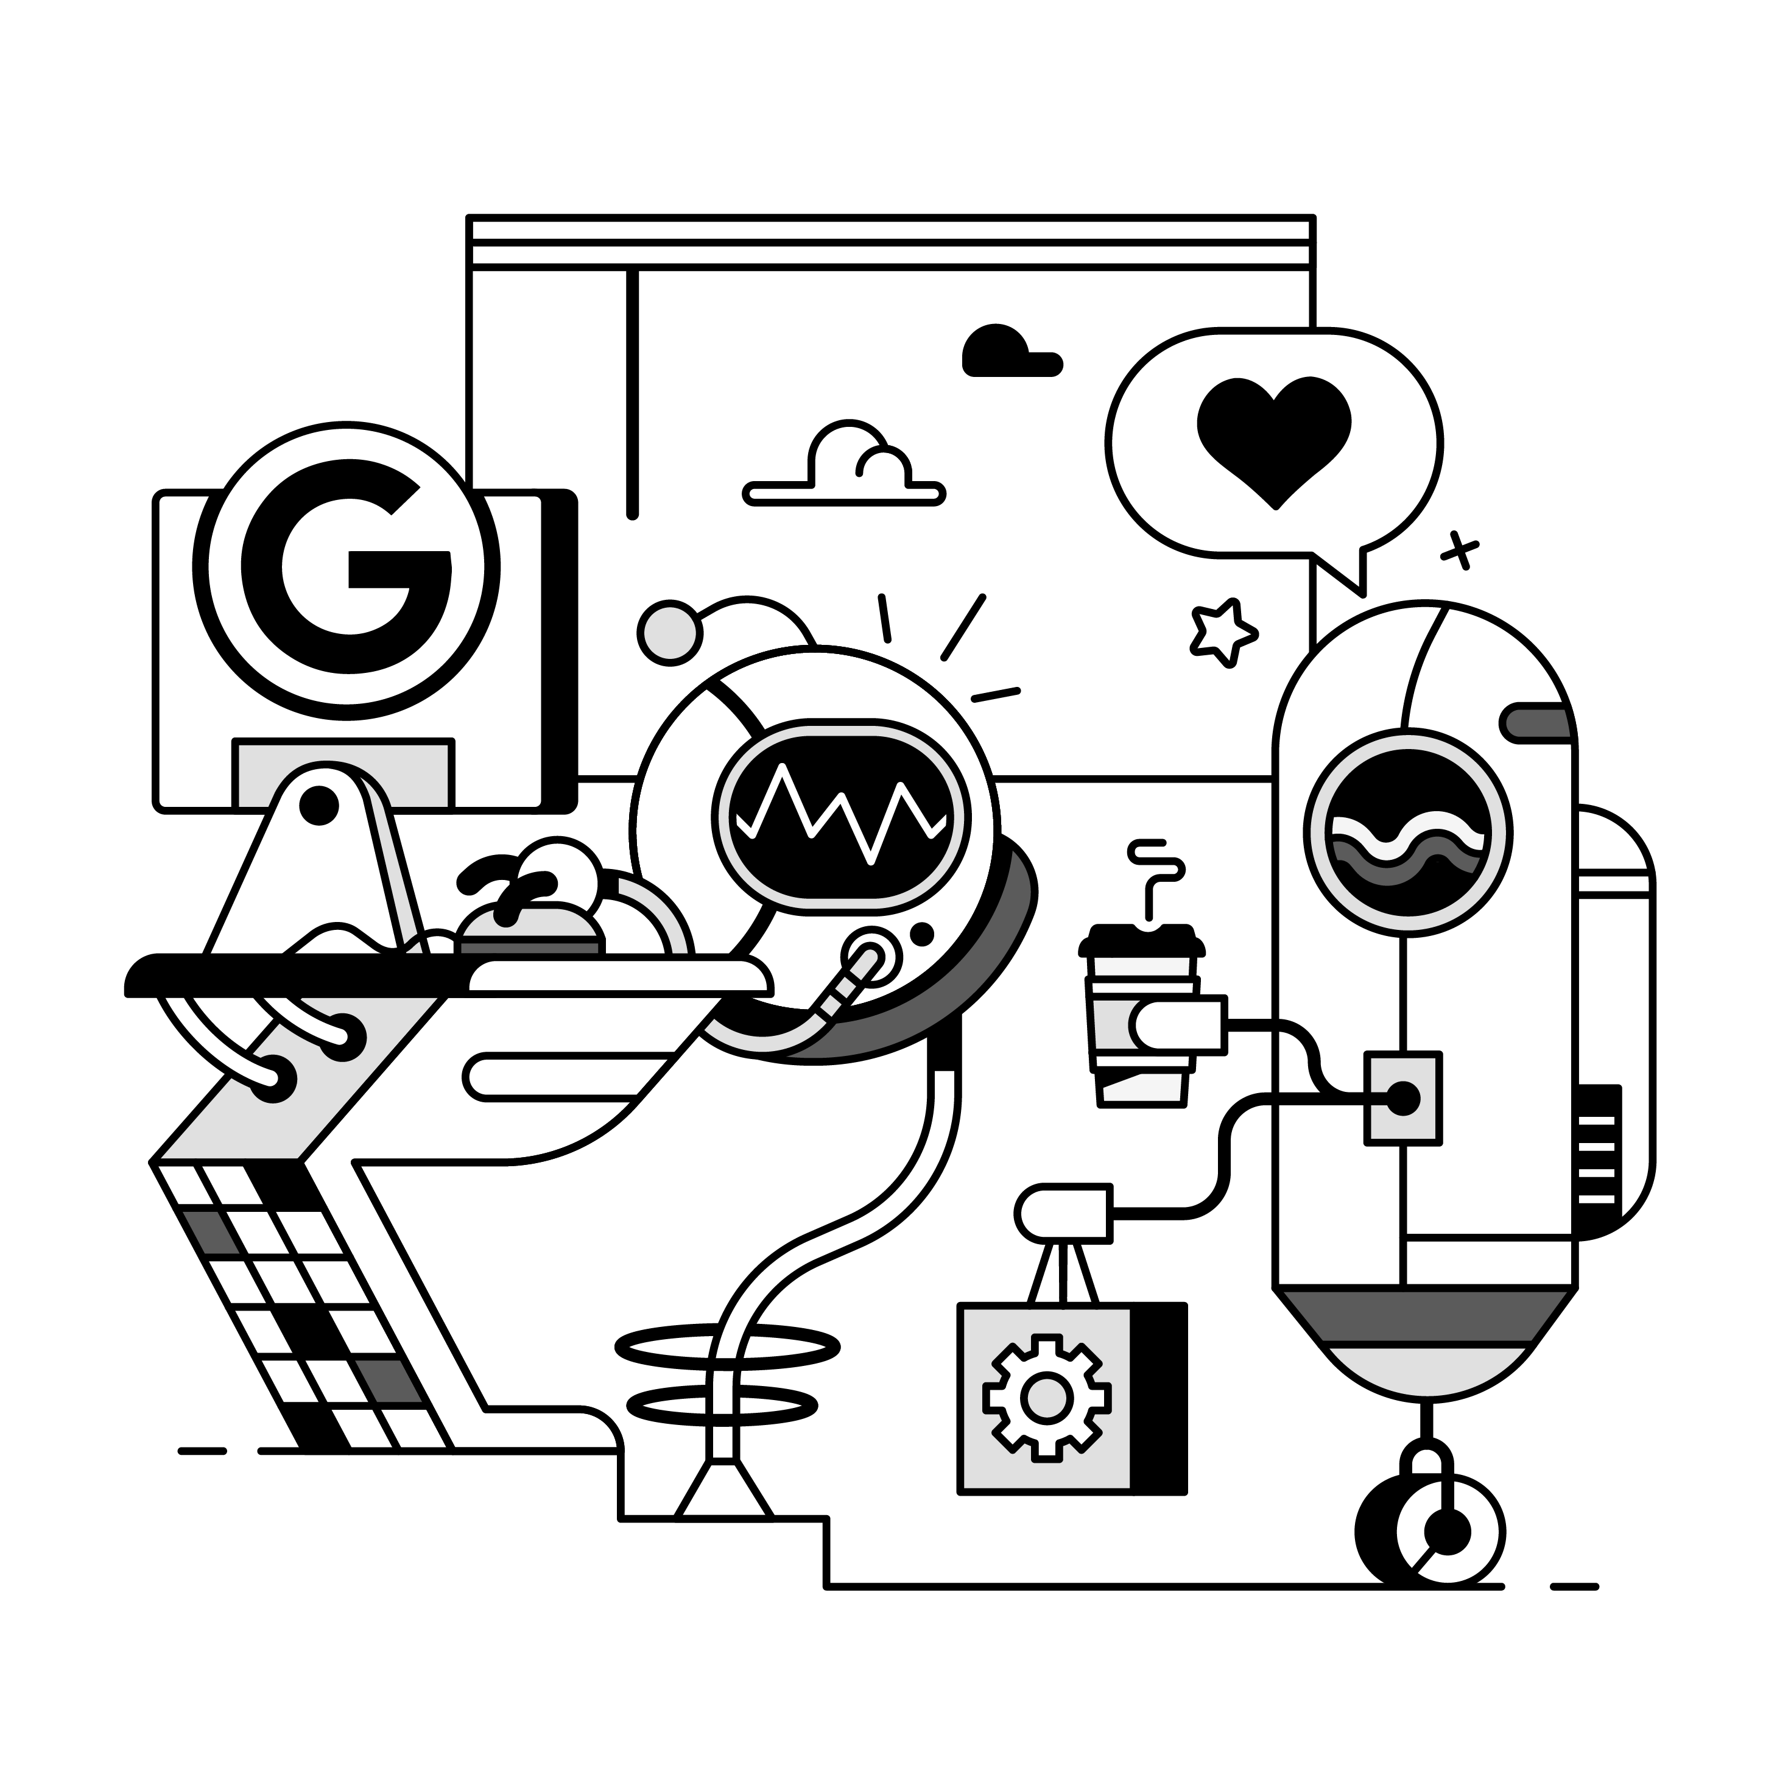
What have we learned today?
Copilots are tools that leverage LLMs to help you
As LLMs are stateless, you have to send the entire conversation history
You can send extra context to an LLM such as files, folders
Tools like Pieces make it easier to build copilots as they provide a lot of the functionality you need
Notes:
Install Pieces and build your own

Slide 20

Build your own copilot, you must!
Install Pieces for free from pieces.app
Use the .NET SDK
Share your copilot with us @getpieces!
Notes:
Install Pieces and build your own

Slide 21

Star Wars copilot
Download from github.com/jimbobbennett/star-wars-copilot
Notes:
Install Pieces and build your own

Slide 22
Thank you

